Slide 1
Lucid Dreams of Sweet Water for All
In summary — the technical production
Immersive installation
in a 6-metre diameter circular room
5 Optoma ZW350ST projectors
4 walls (X config) + 1 onto the scry (3D topography)
Curved screen 16.5m × 2m
Native resolution 4454×800px — modular canvas surface
Sensor-driven interaction
7 ultrasonics (walls) + 2 PIR (entrance) + RPi NoIR (scry)
Driven by TouchDesigner + NDI
Real-time, sensor sync, media playback
The Giant
Table Mountain falls asleep,
dreaming of all visible life
The Washerwoman
Creolised narrator linking
past, present and future
The Scry
3D topography of Cape Town ∅1m
Projection + gesture interaction
Futures Past Programme — Electric South / IFAS-Research / MEAE • Iziko Museums of South Africa

Slide 2
PROJECT TIMELINE
From research to exhibition
Jan — Jun 2026
Feb — Jun 2026
May — Jul 2026
Jul — Sep 2026
Sep — Dec 2026
Research
& Concept
Dev. Acts
1 & 2
Dev. Act 3
Fabrication
Exhibition
Archives, narrative,
concept art, projection R&D
Daniel Hugo illustration,
animation, audio, filming
Salt River video production,
sound, TouchDesigner
Structure build,
calibration, integration
3 months minimum
at Iziko Museums
23 wks
14 wks
10 wks
8 wks
12 wks
Key Milestones
✓
6 Jan
Project launch
✓
23 Mar
Budget approved
→
6 Apr
Paris Mobility
○
27 Apr
Production start
○
17 Aug
Production complete
○
15 Sep
Installation complete
○
18 Sep
Exhibition opens
Total duration: 32 weeks • 31 deliverables • Budget: R 1,200,000

Slide 3
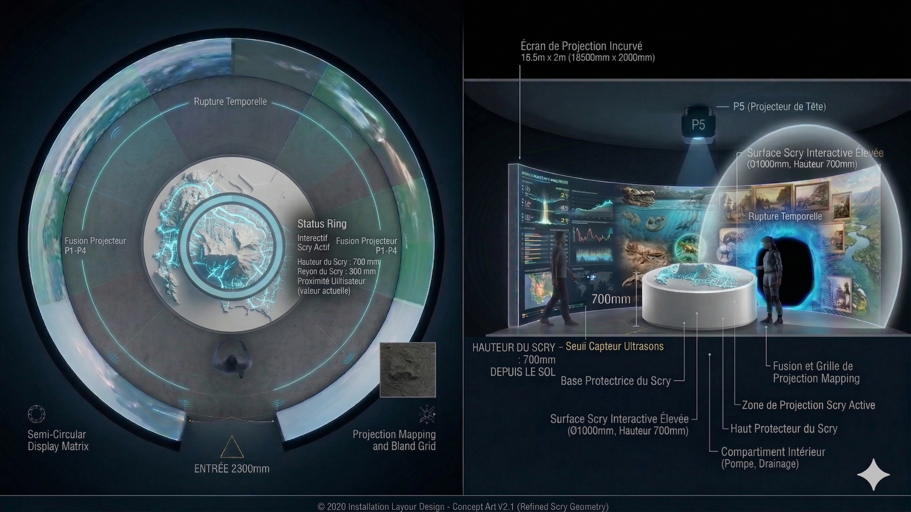
THE INSTALLATION
Room ∅6m — Scry ∅1m — Screen 16.5m × 2m
5× Optoma ZW350ST • 7 ultrasonics • 2 PIR • RPi NoIR • TouchDesigner + NDI • Modular structure 12+ panels • Raised floor

Slide 4
WHAT WE'RE LOOKING FOR
Let's Collaborate
Distribution
Funding
Co-production
Festivals, museums and international
cultural venues to host the
installation on tour
Additional financial support
for international touring
and adaptation to new venues
Creative and technical
partnerships to enrich the
work and extend its reach
The installation is modular and
transportable — designed to be
deployed in new spaces
around the world
Current budget: R 1,200,000
(production + Iziko exhibition)
Touring needs: to be defined
per opportunity
Open to collaborations:
localised narrative content,
translation, cultural
adaptation of acts
L. de Laroche Souvestre (Producer) • S. Summers (Artistic Director) • K. Marais (Technologist)
R. Cloete (Junior Producer) • Dr L. Platzky (Advisor)
University of the Western Cape — Immersive Zone — Cape Town, South Africa
infouih@uwc.ac.za • +27 21 959 2000

